Slide 1
Toward a Reduced-Form Factor Portfolio
TTIC 31220 Final Project Presentation
Kabir Sawhney and Joseph Denby
March 13, 2019

Slide 2
Agenda (May delete this slide later, just a skeleton for us for right now)
Motivation & Background
Description of Data
Methodology
Results & Conclusions

Slide 3
Motivation & Background
Different financial assets (stocks, bonds, etc.) are all affected by a similar set of underlying risks (inflation, economic growth, etc.). In finance theory, the returns on these assets can be modeled as a linear combination of the returns to these risks, plus an error term.
There are a lot of proposed risk factors, so some researchers have used linear PCA to derive a smaller set of risks that perform well in explaining equity returns.
Our project sought to extend this work to non-linear dimensionality reduction, to see if we could find a method that worked better than linear PCA to predict stock returns.

Slide 4
Description of Data
Our data was monthly returns on stocks and risk factors from 1963 to 2013.
For our response variable, stock returns, we used the S&P 500 and the five longest-tenured stocks in the Dow Jones Industrial Average (ExxonMobil, Procter & Gamble, United Technologies, 3M, and IBM).
For the risks, we used a set of factor strategies developed by Novy-Marx and Velikov. They collected the returns to rules-based strategies designed to provide exposure to different factors.
We compared our results with the most popular theoretically-constructed risk factor portfolio, the Fama-French three-factor model.

Slide 5
Methodology
Split the data into training, validation, and test sets in time – older data was our training and validation data, while the most recent returns were our test data.
Tune hyperparameters for linear PCA, kernel PCA (with the polynomial and RBF kernels), Isomap, and Laplacian eigenmaps.
Choose the two best-performing dimensionality reduction methods, and get the learned representation on the combined training and validation sets.
Use the learned representation to fit a linear regression model, and compare performance on the test set with the performance of the Fama-French model.

Slide 6
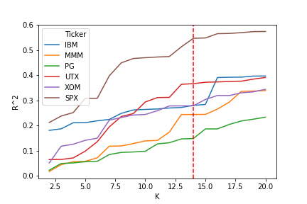
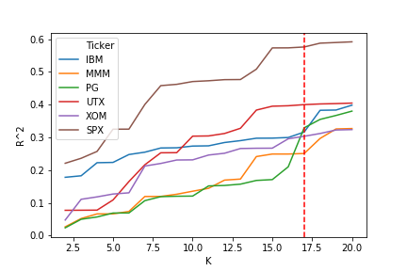
Results: Method Selection & Tuning
Tuning Number of Components for Kernel PCA
(RBF Kernel, Gamma = 1x10⁻⁴)
Tuning Number of Components for Linear PCA

Slide 7
Results: Explanation of Returns

Slide 8
Conclusions
For explaining individual stock returns, non-linear dimensionality reduction methods don’t offer an improvement over standard linear PCA. This result suggests that the perspective that asset returns are a linear combination of returns to risk factors is broadly accurate.
None of our learned representations performed as well as the Fama-French model, on any of the stocks. However, it’s hard to make a general conclusion, as this result might have been different if we used a different set of underlying factors.

Slide 9
Questions?

